Slide 1
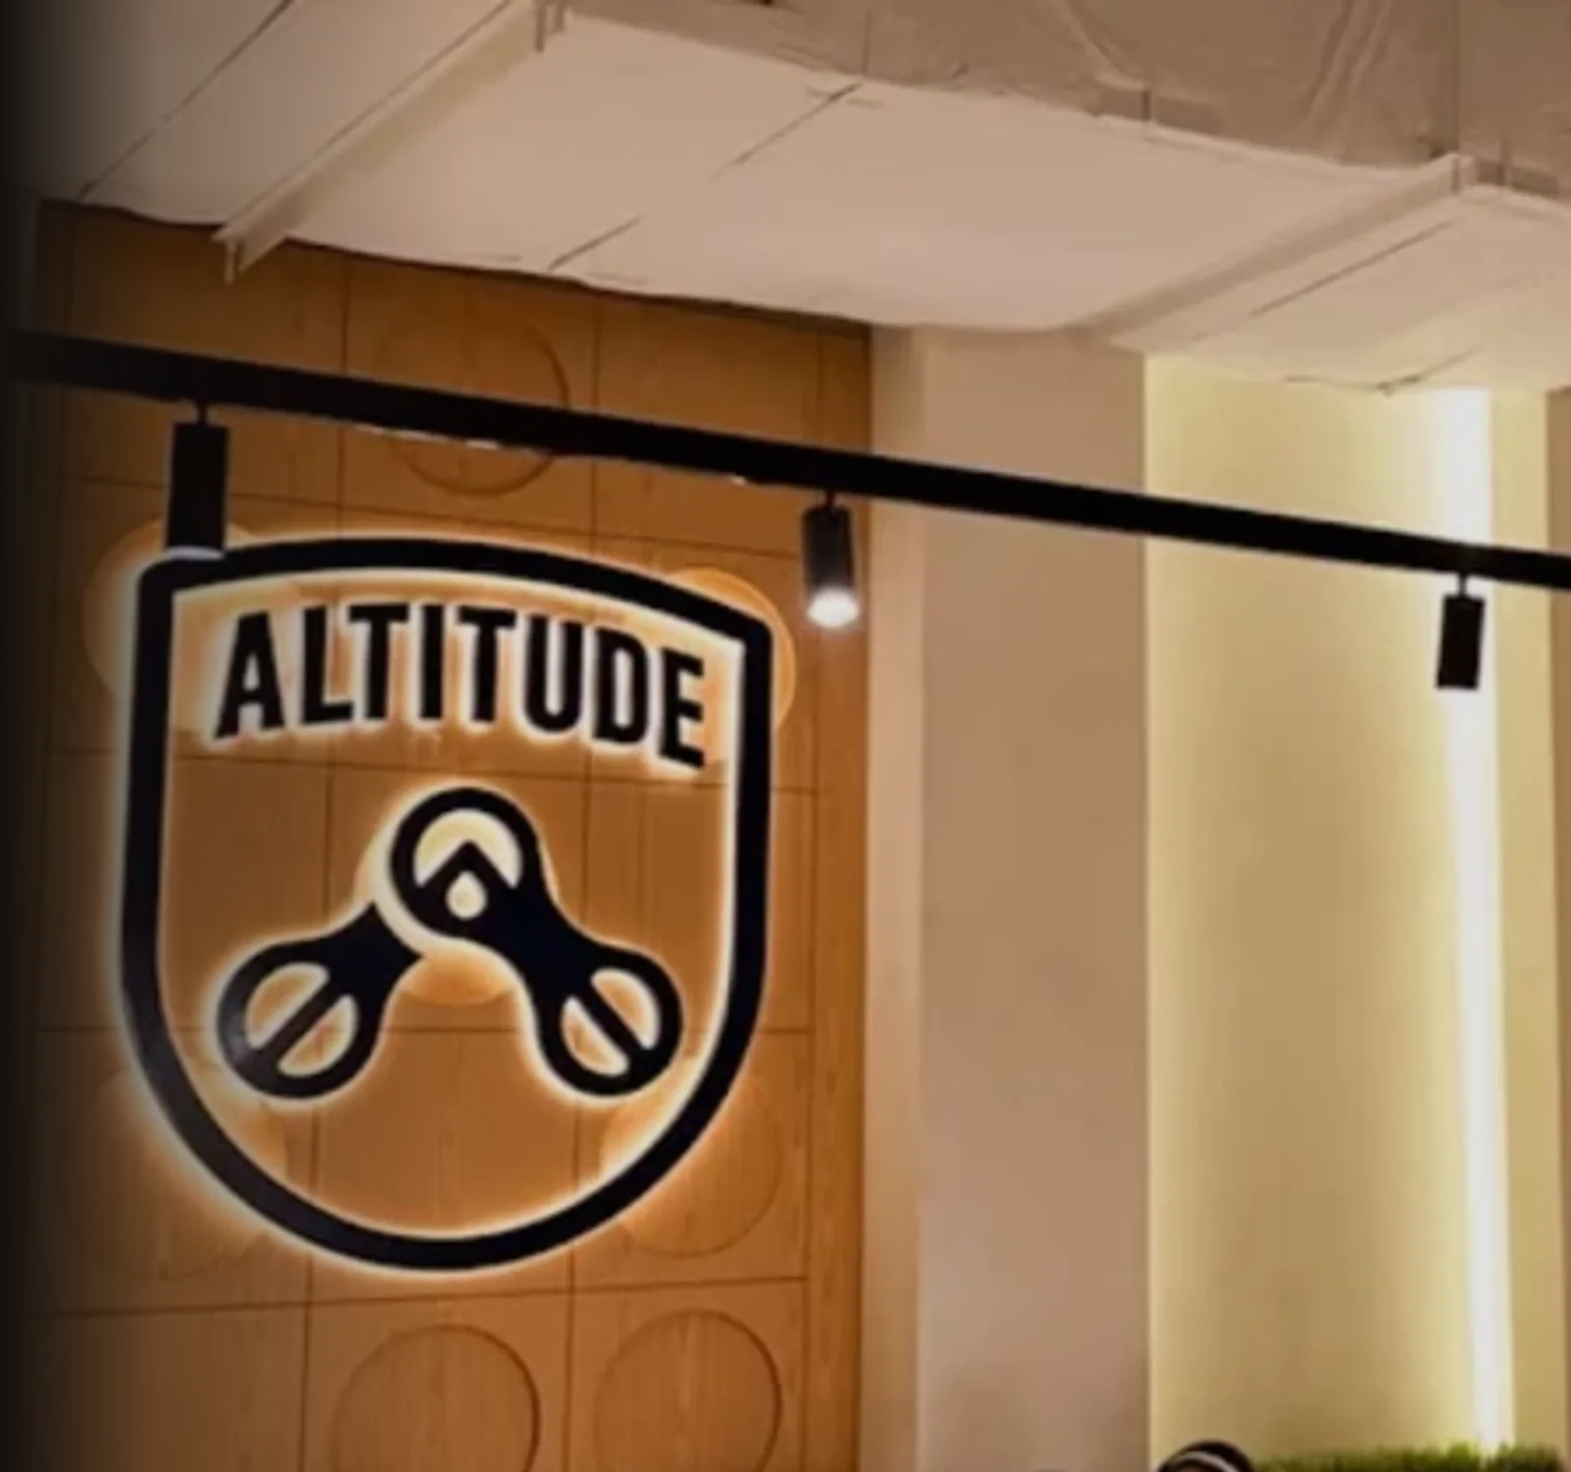
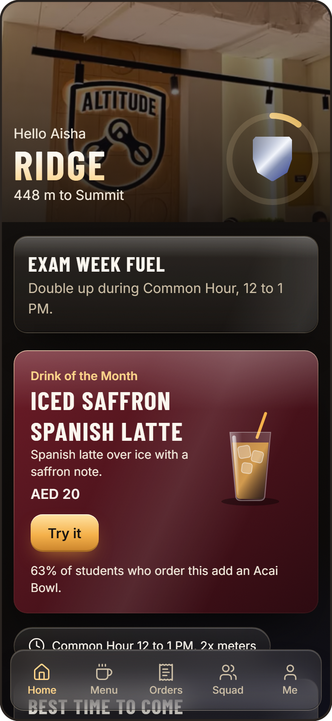

ASCEND
ALTITUDE CAFE, RIT DUBAI
Skip the line. Earn the view.
The order-ahead and loyalty app that turns the daily coffee run into a climb.
Team Pythons | ideaForge, AIRC x Altitude
Notes:
Open with the problem: a short break and a long line. ASCEND gives the break back, then gives students a reason to return. About 30 seconds.

Slide 2
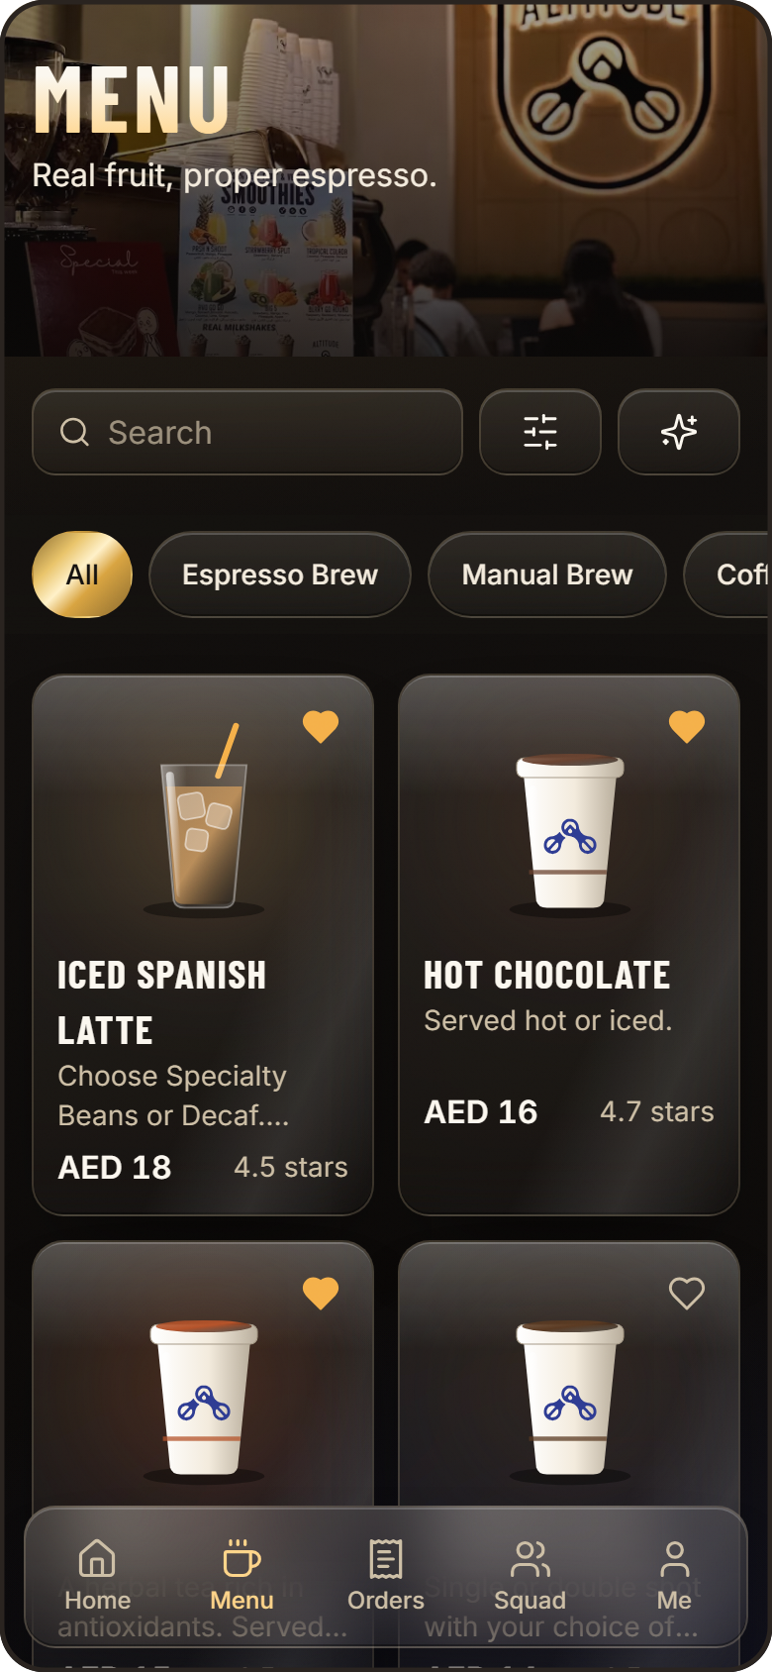
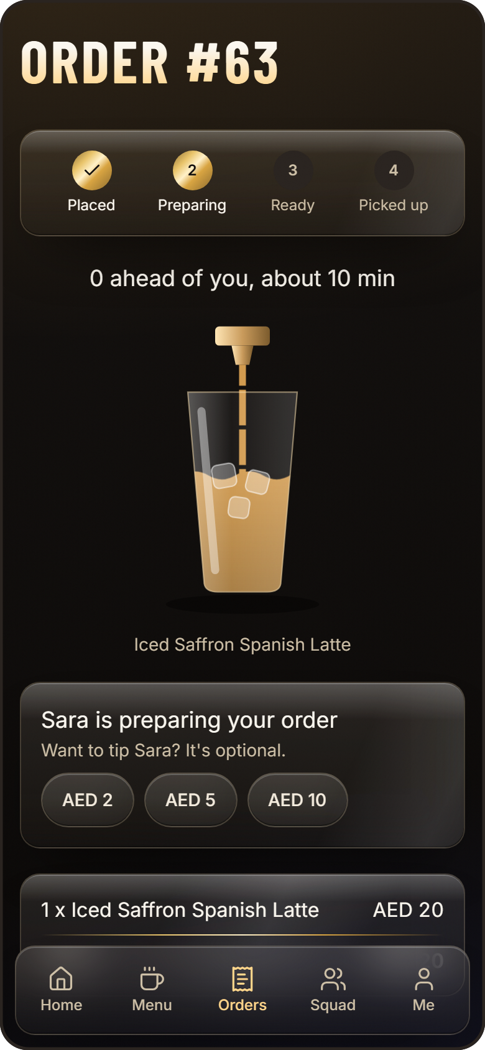
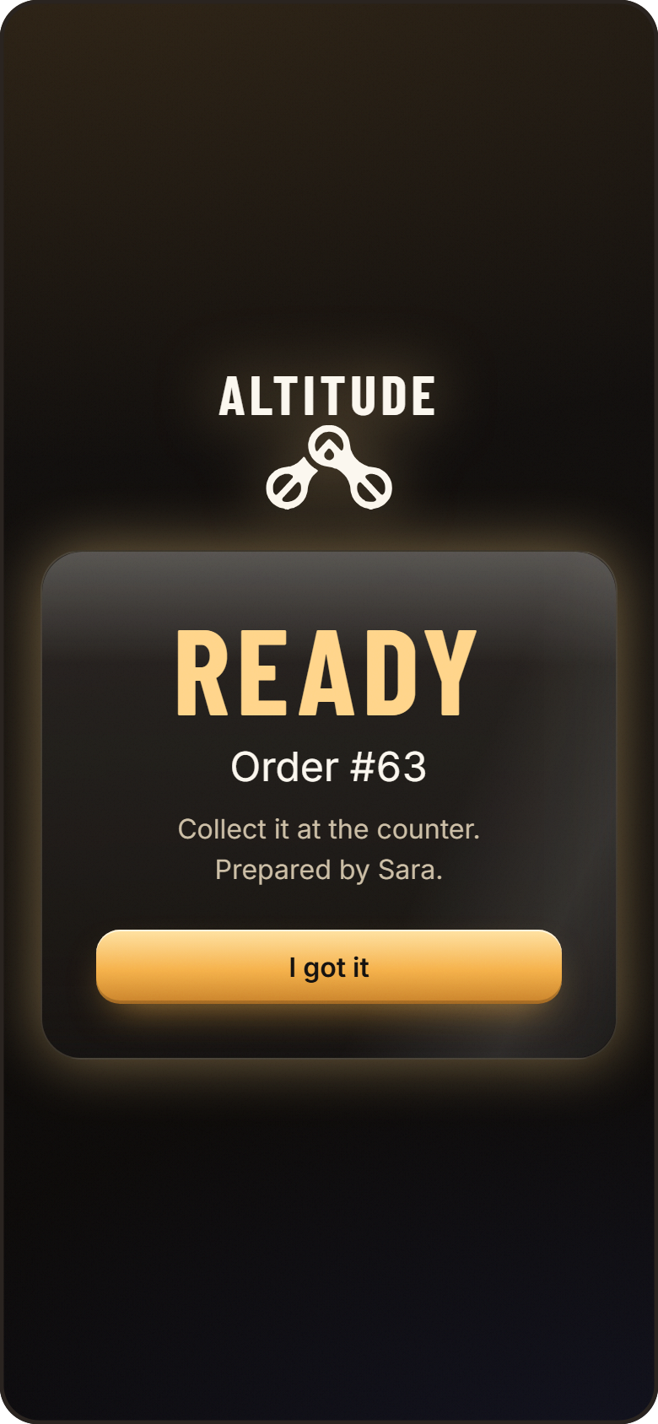
ORDER. WATCH. COLLECT.
The line disappears. The break comes back.
ORDER AHEAD
WATCH IT MADE
WALK UP
The real Altitude menu, dietary filters, and a mood picker for when you cannot decide.
Your exact drink fills on screen. See the queue, see your barista, and tip if you like.
A sound and pop-up the moment it is ready, on whichever screen you are on.
Notes:
Run the live order here if time allows. Order on the phone, point out the drink filling and the barista name, then the Ready alert. About 60 seconds.

Slide 3
EVERY COFFEE IS A STEP UP
Loyalty that students actually want to play.
PEAK
1,600 m
SUMMIT
800 m
RIDGE
300 m
BASE CAMP
0 m
1 METER PER AED
COMMON HOUR
SQUAD BONUS
REWARD WHEEL
Every dirham spent takes you higher.
Double meters from 12 to 1 PM.
Your friends share 10% of what you earn.
One free spin for every 5 orders.
Notes:
Meters are earned on every order. Tiers unlock perks. Common Hour moves demand into a set hour, and squads bring friends in. About 40 seconds.

Slide 4
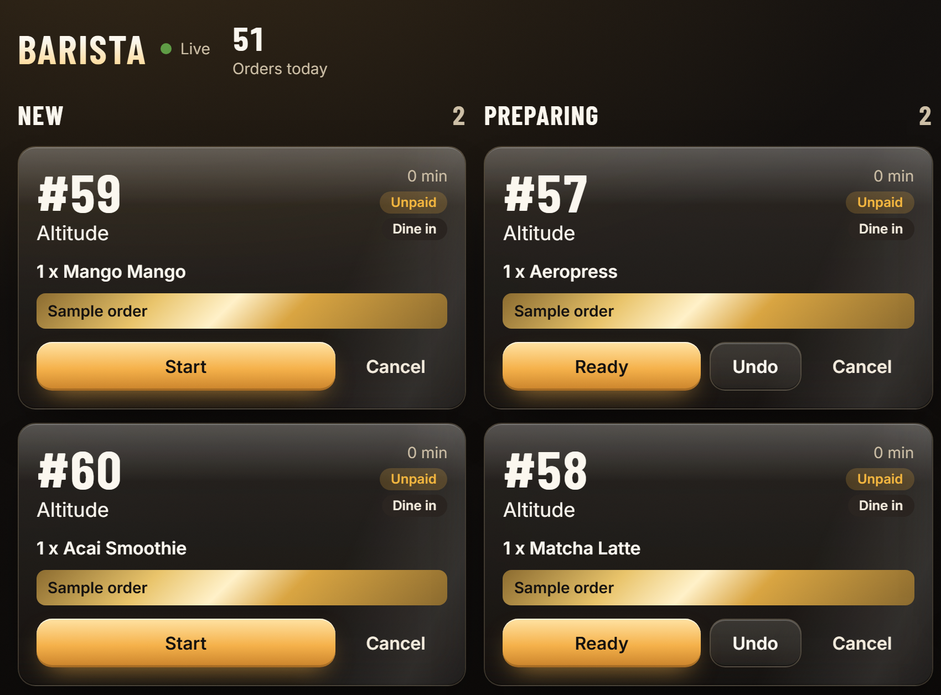
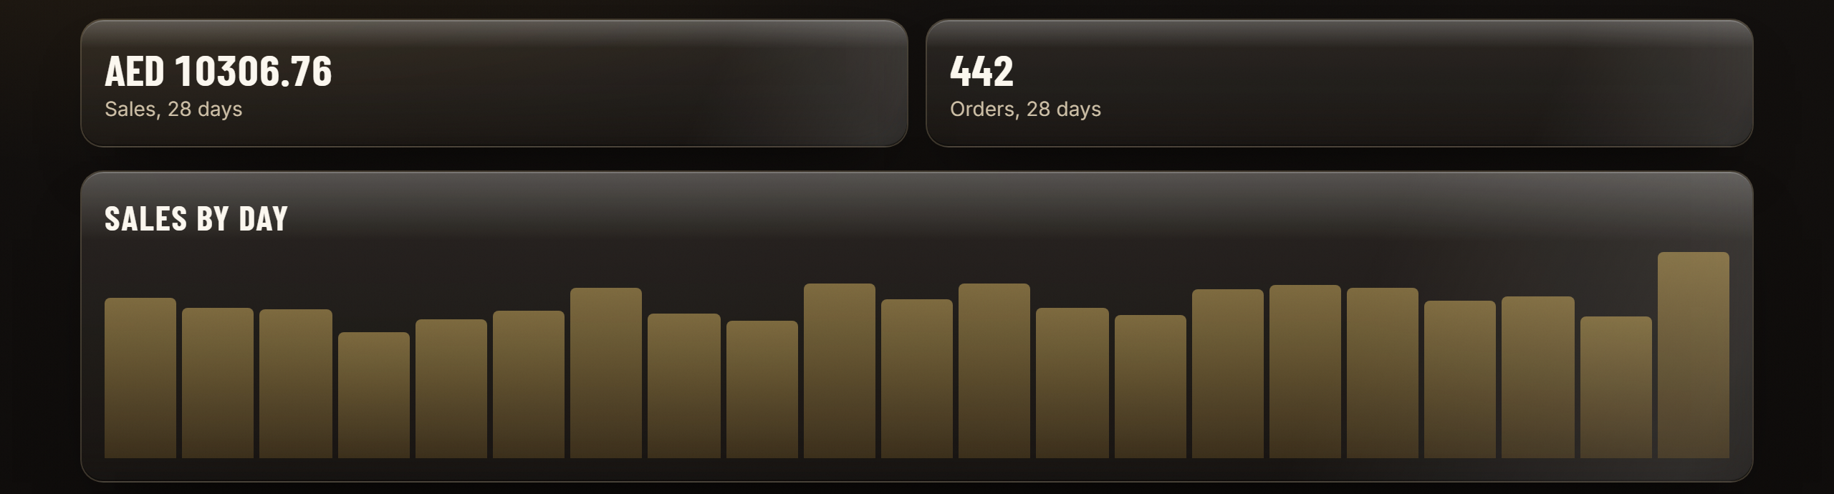
BUILT FOR THE REAL COUNTER
Runs on the laptop the cafe already owns.
ADMIN CONSOLE
LIVE DEMO
Menu, promos, reviews, and sales in one place. Figures shown are demo data.
altitude-ascend.vercel.app
40
39
0
Try it on your phone now.
real menu items
automated tests
new hardware
BARISTA BOARD
Live orders, one-tap status, sold-out switches.
NEXT: group carts, real payments, seat reservation
Notes:
Show the barista board and admin analytics. The sales figures are demo data. Close by inviting the judges to try the live link. About 40 seconds.

